Slide 1
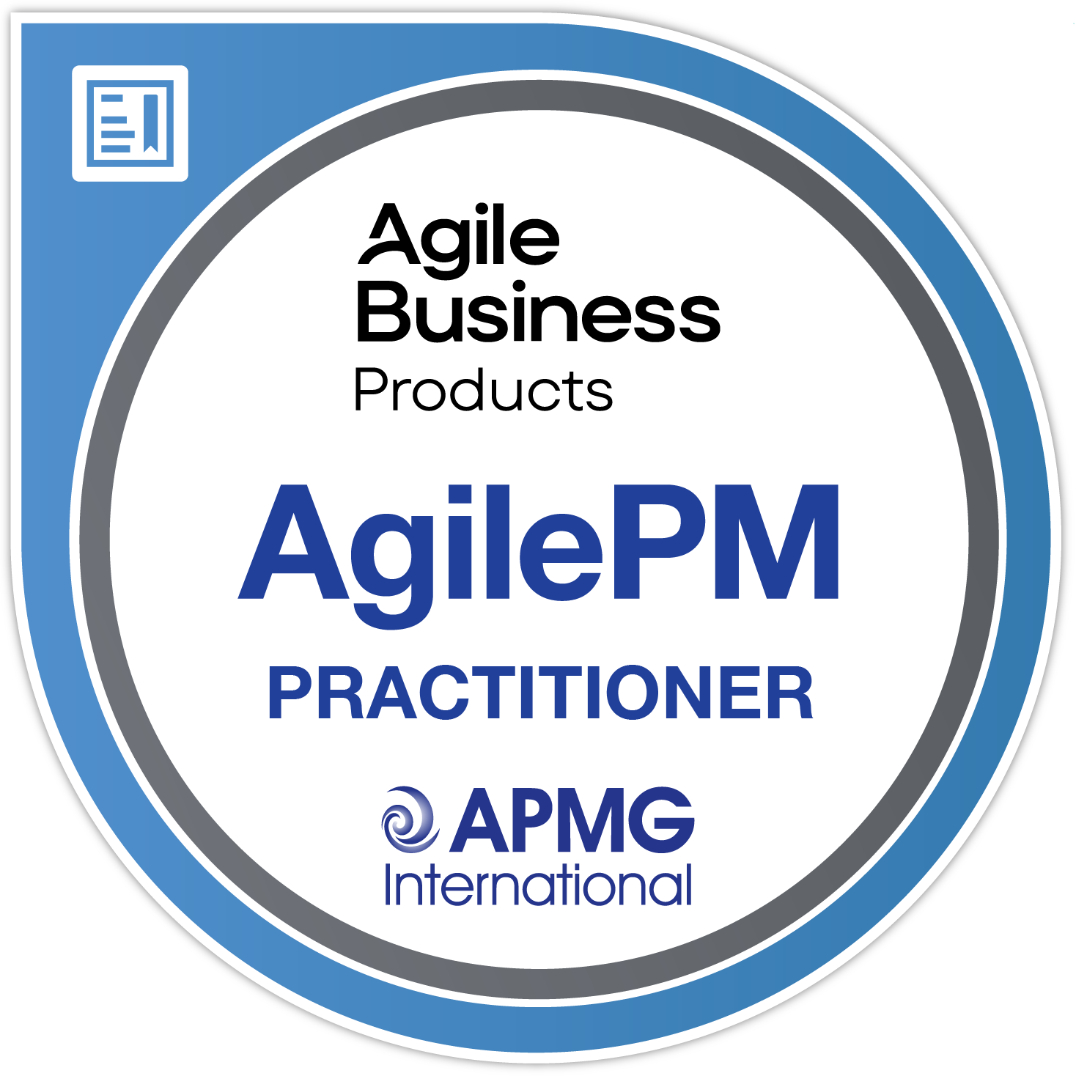
reasons to invest in AgilePM® (Agile Project Management) training and certification
10
apmg-international.com/AgilePM

Slide 2
1
Deliver change faster and more effectively by implementing a tried and tested approach to agile project management
apmg-international.com/AgilePM

Slide 3
2
Gain a deep understanding of agile project management principles, concepts and processes, and how to apply them to deliver maximum value for successful projects
apmg-international.com/AgilePM

Slide 4
3
Enhance your ability to facilitate better interaction between stakeholders, developers, and project teams, ensuring clear understanding and alignment
apmg-international.com/AgilePM

Slide 5
4
Position yourself as a key player in agile projects, capable of driving project success through insightful management and leadership
apmg-international.com/AgilePM

Slide 6
5
Boost your career, confidence, and credibility with digital recognition on your CV and social profiles, showcasing your alignment with a professional body
apmg-international.com/AgilePM

Slide 7
6
Stand out with a certification that sets the global standard for agile project management, making you a sought-after professional in any industry
apmg-international.com/AgilePM

Slide 8
7
Use agile principles to enhance collaboration, innovation, and efficiency, ensuring your projects meet and exceed stakeholder expectations
apmg-international.com/AgilePM

Slide 9
8
Deepen your understanding of advanced agile frameworks, improving your ability to adapt and succeed in rapidly changing project environments
apmg-international.com/AgilePM

Slide 10
9
Position yourself as a crucial link between strategic goals and operational execution, mastering the art of value-driven project leadership
apmg-international.com/AgilePM

Slide 11
10
Successful candidates can claim an additional Business Agility Professional Level 1 digital badge from the Agile Business Consortium, offering candidates additional recognition of their achievements
apmg-international.com/AgilePM

Slide 12
Don’t just take our word for it….
96% of respondents either agreed or strongly agreed that the learning/certification experience has enhanced their ability to plan and manage projects.
APMG International 2024 AgilePM candidate survey (381 responses)
apmg-international.com/AgilePM

