Slide 1
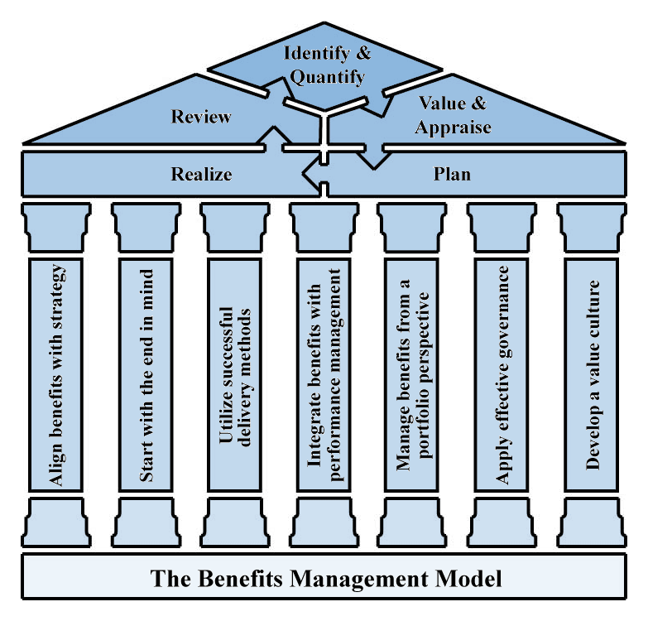

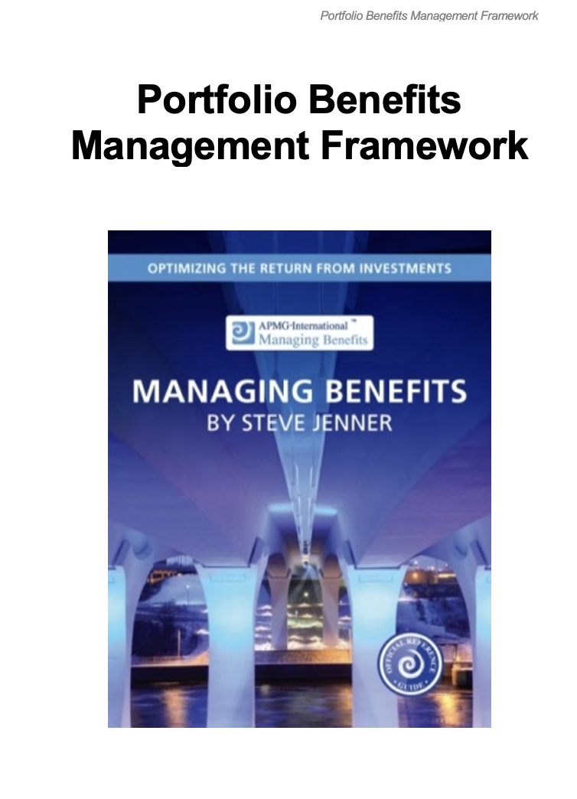
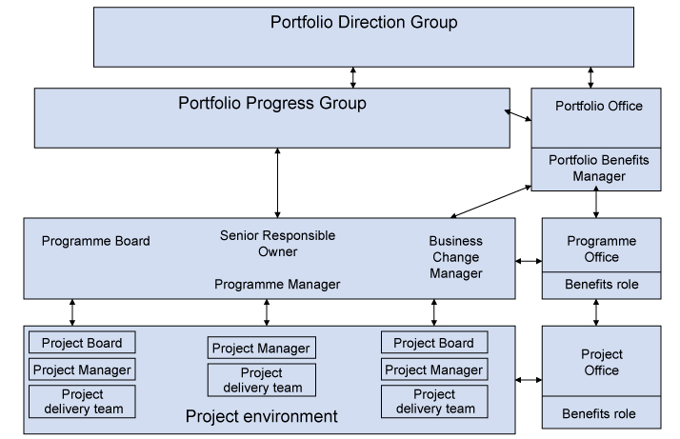
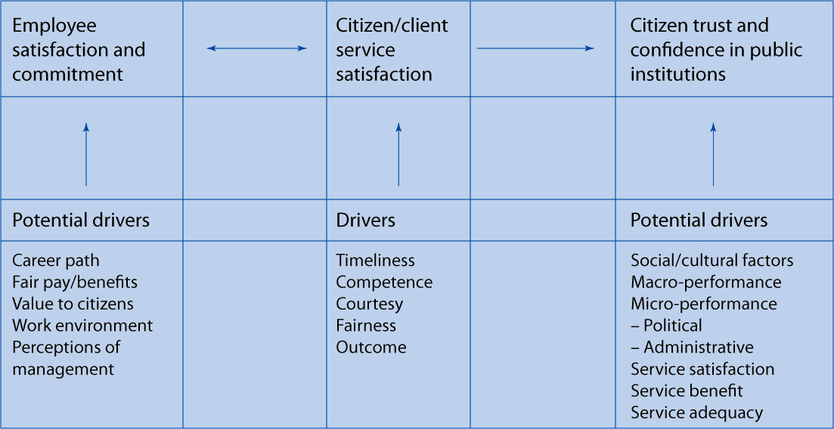
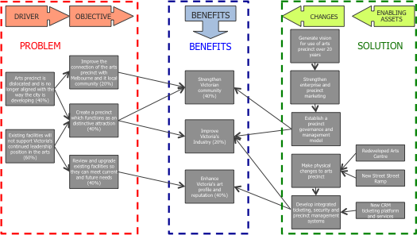
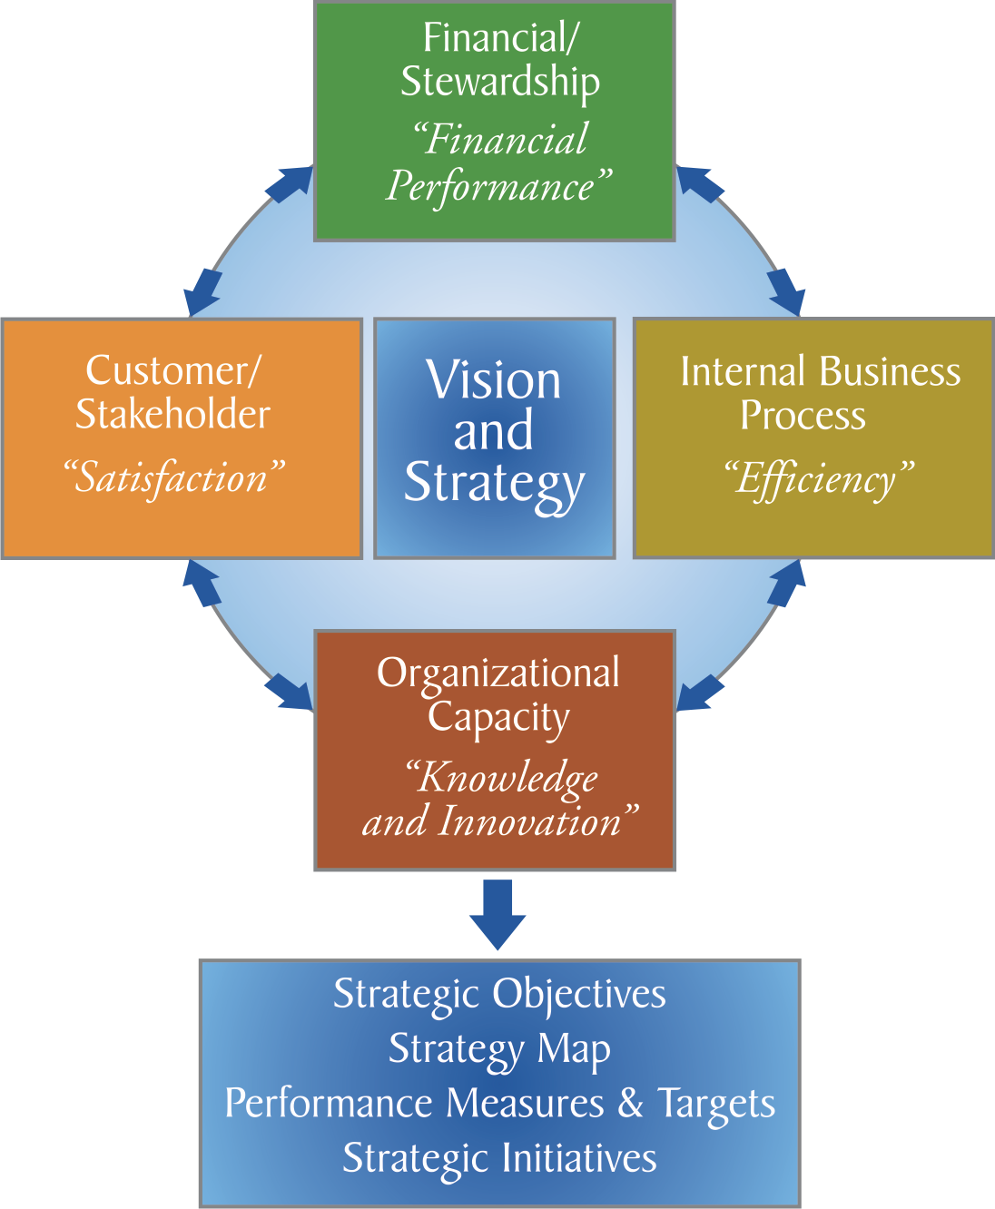

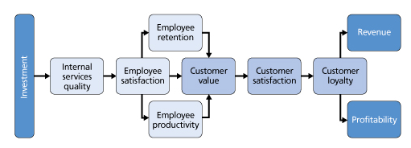


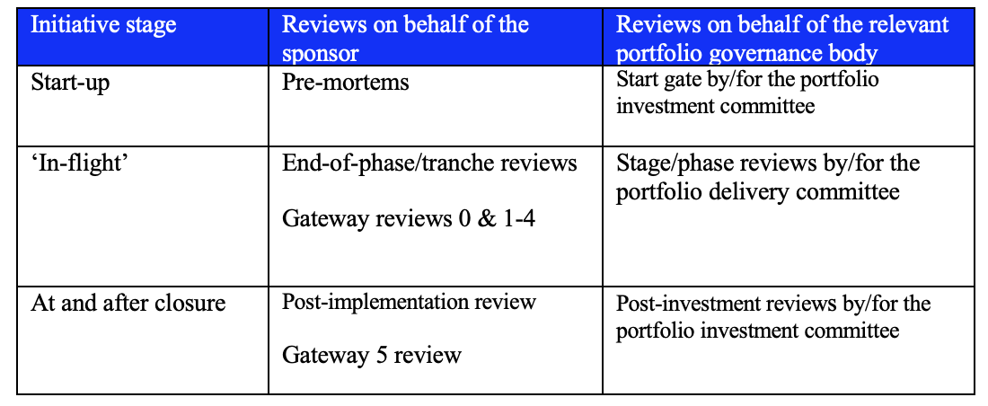
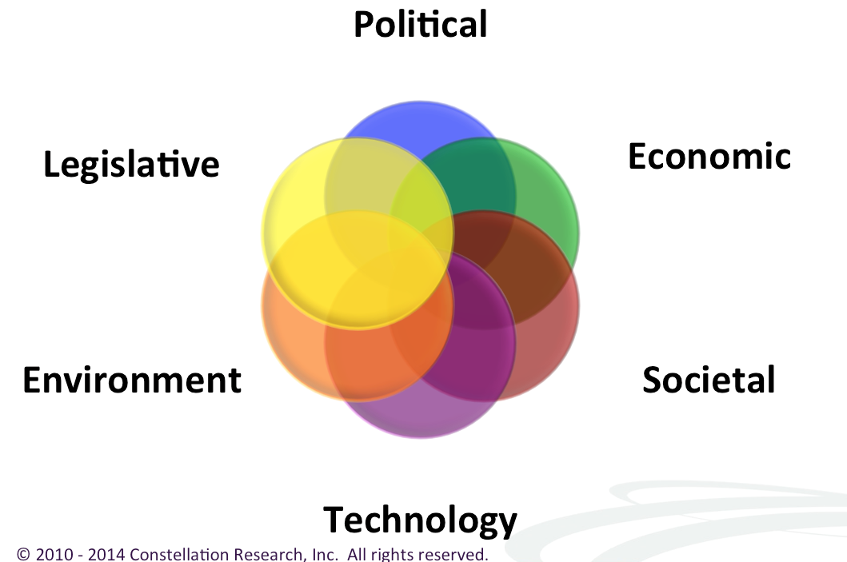
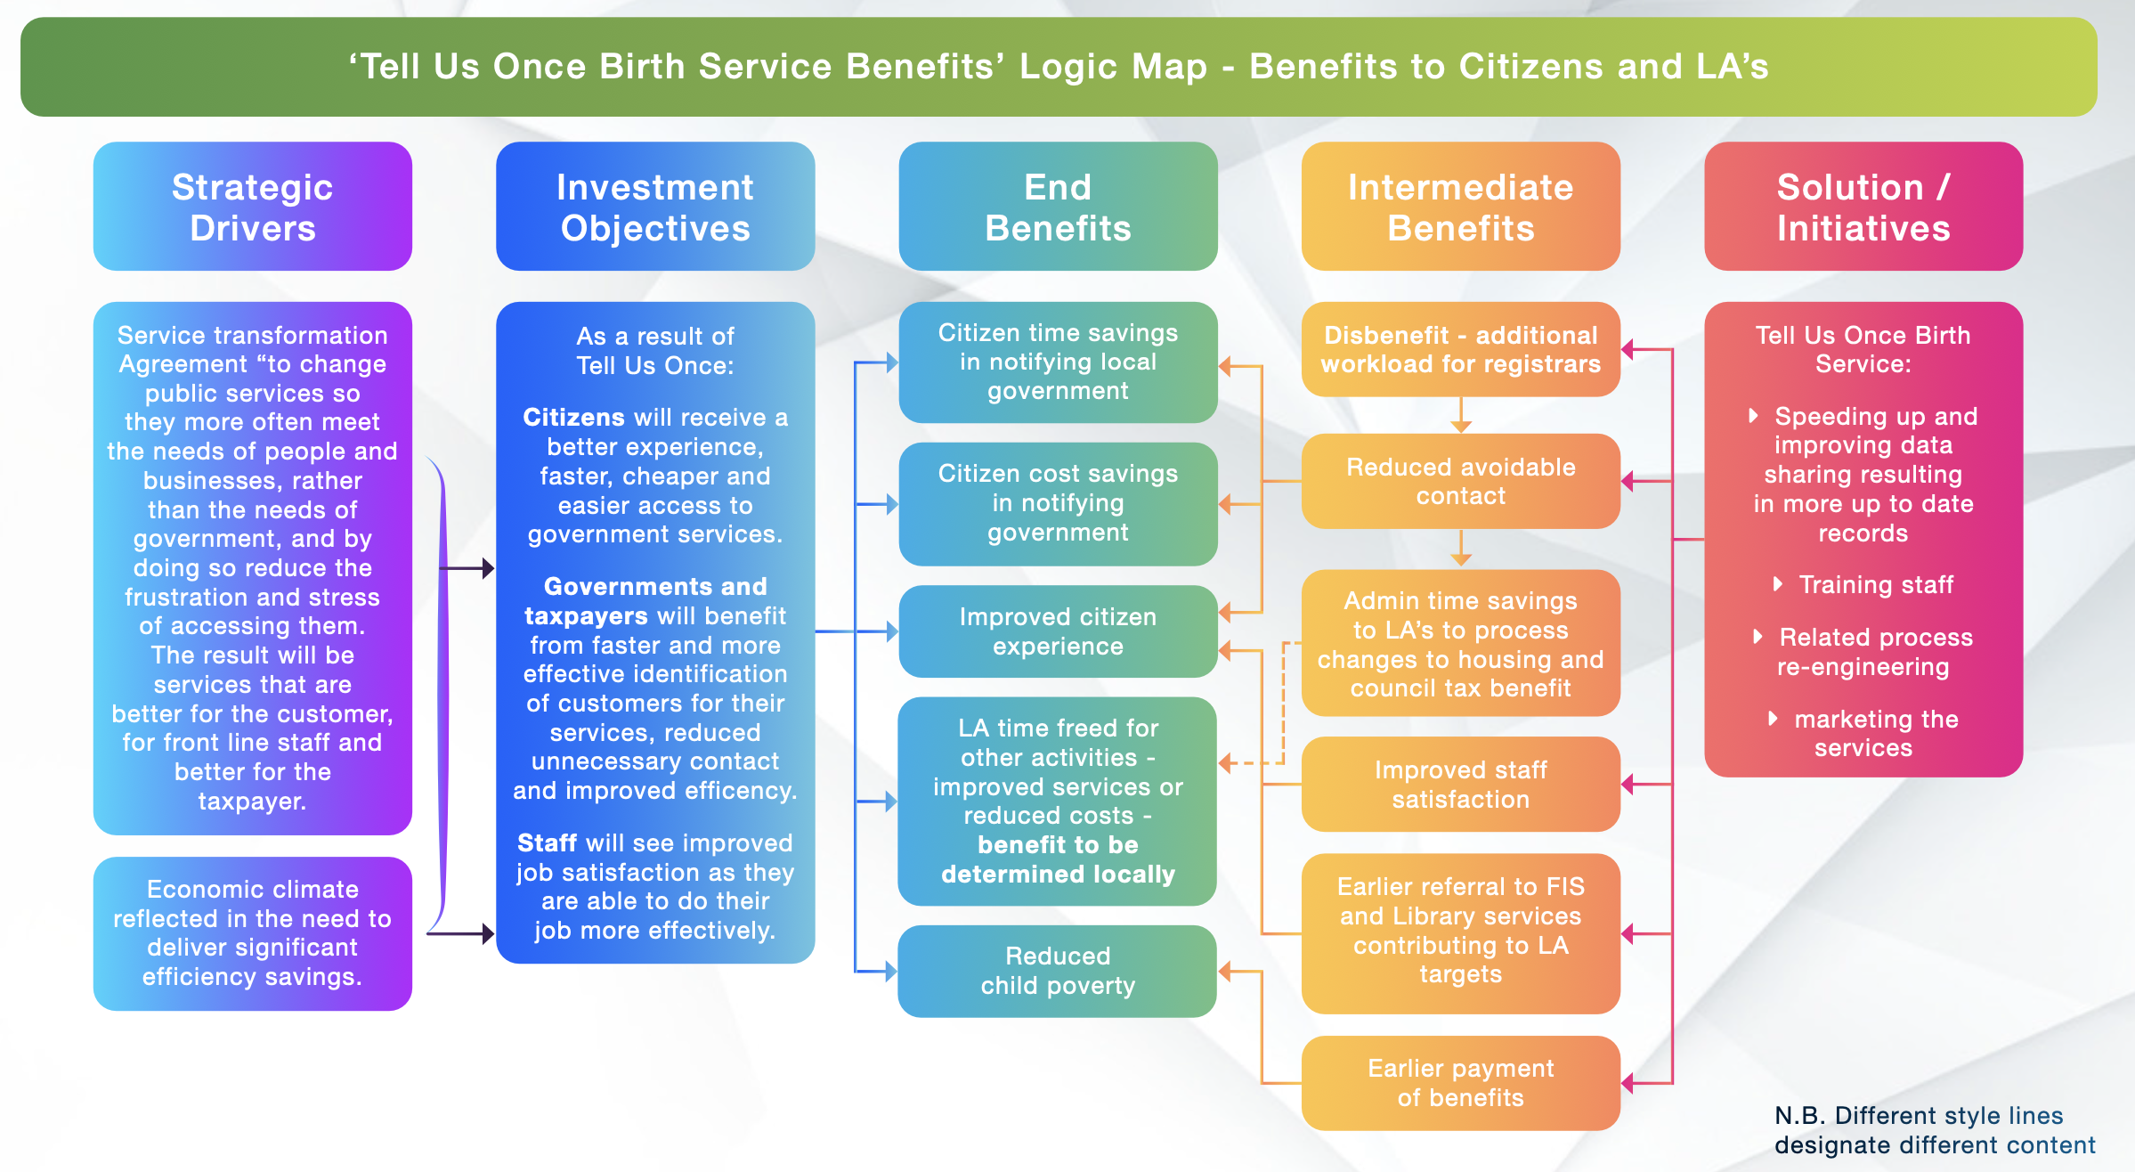
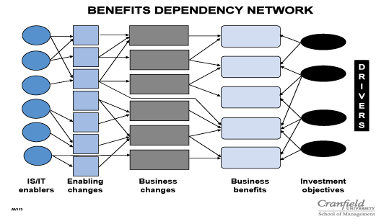
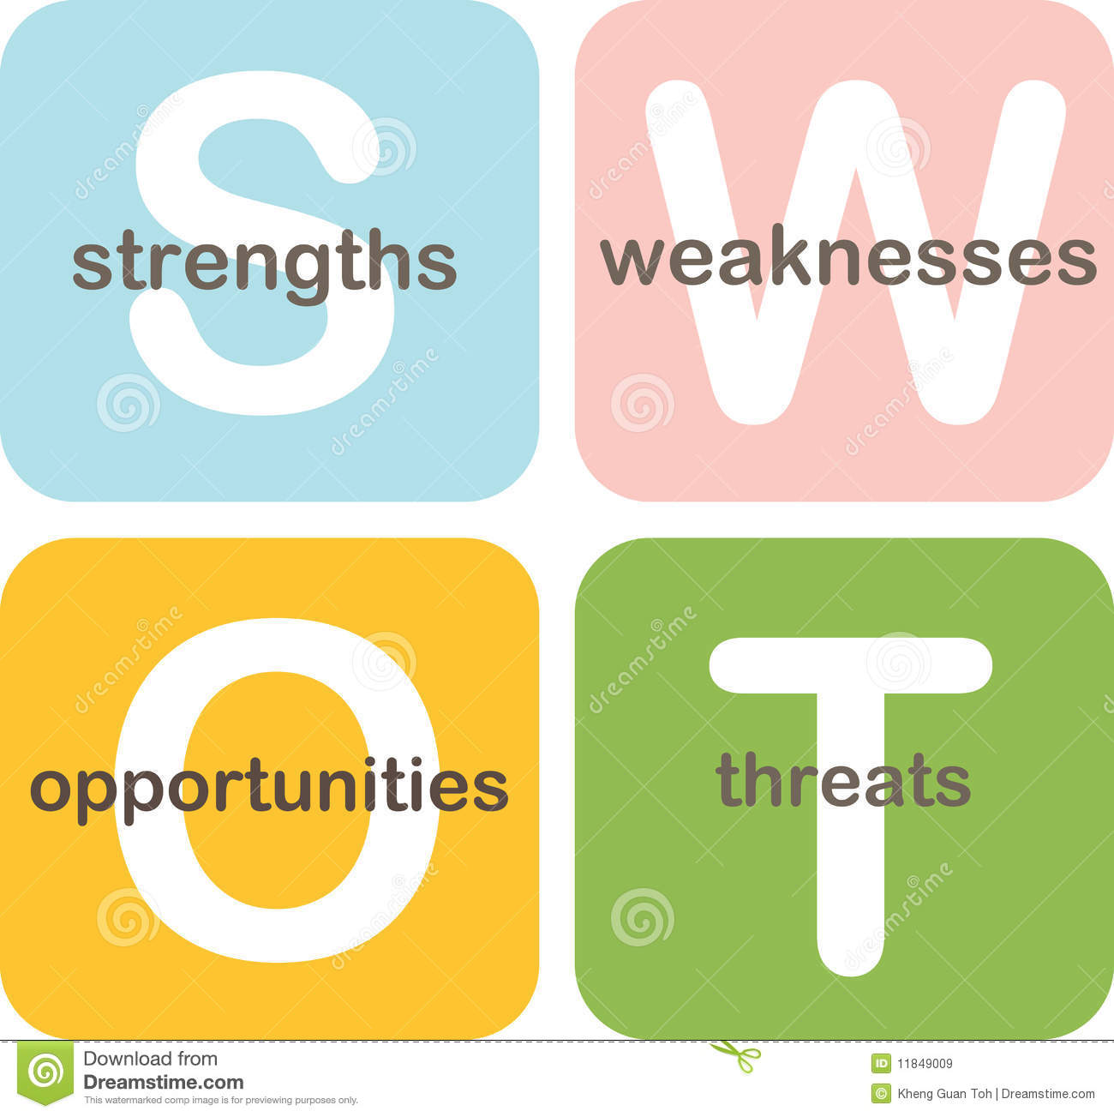


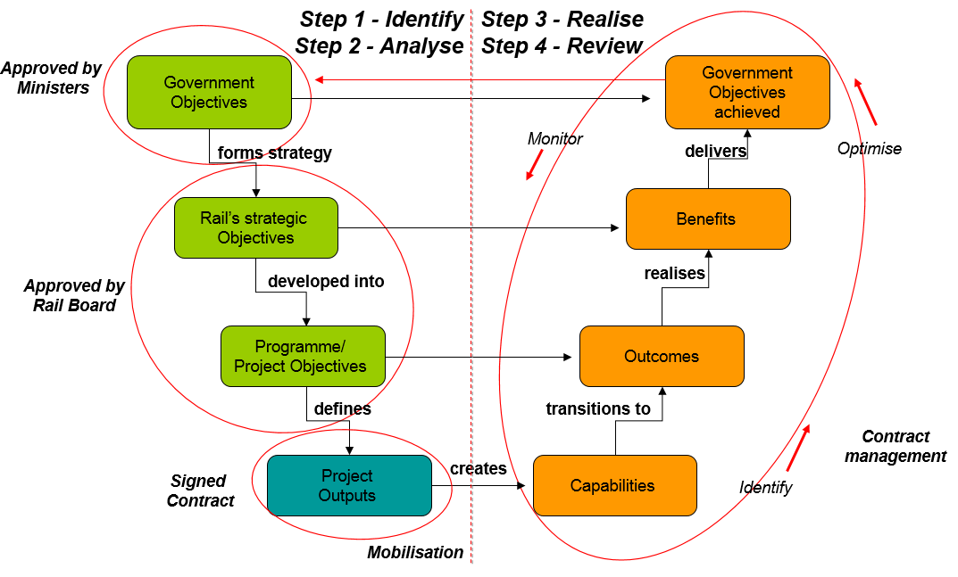
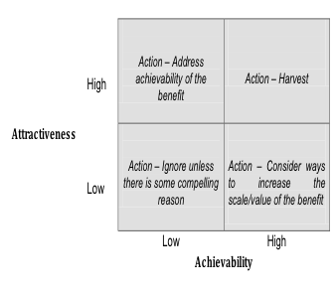
Managing Benefits ‘Story on a Page’ - Principles, Practices and Techniques
PRINCIPLES
1 – Align Benefits with Strategy
2 – Start with the end in Mind
3 – Utilize Successful delivery methods
4 - Integrate Benefits with Performance Management
5 – Manage Benefits from a Portfolio Perspective
6 – Apply Effective Governance
7 – Develop a Value Culture
Service Value Chain
Investment Logic Map
Balanced Scorecard
Coordination
Commitment
Competencies
Service Profit Chain
Clear
Aligned
Consistent
Active
Measurement difficulties
Common misconceptions
The ‘Knowing-Doing Gap’
Transparency as a barrier
Cognitive biases
Reviews for the Sponsor & Portfolio governance body
Benefits Discovery Workshops
Barriers to Success
PESTLE
Benefits Logic Map
Benefits Dependency network
Results Chain
Customer insight
Customer Segmentation
Customer Journey
Focus Groups
Ethnography
Front Line
Portfolio Based Application
Benefits eligibility rules / Portfolio Benefits Categorization
Portfolio Benefits Realization Plan
Portfolio Benefits Reviews
Arrangements to manage benefits post-closure
Tracking and reporting at Portfolio Level
Post-Implementation Reviews
Portfolio Benefits roles & documentation
Cognitive Biases
Strategic Misrepresentation
SWTEIM
Accountability – Validation with beneficiaries
Book the Benefits
Independent challenge
Gates and Portfolio reviews
Self serving
Hindsight
Outcome
Texas Sharpshooter
Cognitive Biases
Expectation Bias
Availability Bias
Groupthink
WYSIATI
Review
Identify and
Quantify
Categorization
Reporting
Baseline current performance
Reference Class Forecasting
Optimism Bias Adjustments
Range forecasting
Sensitivity Analysis
Monte Carlo
Confidence ratings
Appraisal of initiatives
Practices
Cost-benefit analysis
Real options analysis
Cost effectiveness analysis
Multi-criteria analysis.
Valuing Benefits
Financial
Efficiency
Non-financial
Discounted cash flow
3. Winning hearts and minds
1. Transition management
Realize
Value and
Appraise
Multi Criteria Analysis
Align Incentives
Power of Conversations
New routines
Apply learning's
Measures that engage and influence
Utilize Storytelling
Enthusiastic benefits realization
Implement & Sustain
Plan
Approaches
Driver based analysis
Benefits-led initiatives
Benefits eligibility rules
Consistent approaches
Staged release of funding
Top five benefits
Benefits Realization Plan
Report progress
Post-implementation reviews
Raise awareness
2. Tracking and reporting
Big Bang
Incremental
Opportunistic
One version of truth
Clear line of sight
Pareto (80:20) rule
Manage by exception
Ensure accountability and transparency
The realization of identified benefits
The changes on which they are dependent
Mitigation of dis-benefits (both expected and unexpected)
Identification and leveraging of emergent benefits.
Forecasts vs. Targets
Opportunity Management: capturing emergent benefits via, Modular/Agile Approaches, ‘Scout and Beacon’, Opportunities Taxonomy, participative stakeholder engagement, Portfolio approach.
Plan ELEMENTS
Validation
Prioritization
Pre-transition
Selecting Measures
Risks
Stakeholder Engagement
Documentation
Check eligibility rules
‘Dog that didn’t bark’
Overlaps/dependencies
Validation with owner
Book the benefits
Link to Strategic Obj
Agree % contribution
Primary Inv. Objective
Pair-wise comparisons
Establish measurements
Monitor realization
Plan transition
Communicate change
Assess readiness
Quant/Qualitative
Financial / Non
Leading/lagging
Direct or Indirect
Forecasting failure
Delivery failure
Change failure
BM failure
VfM failure
Collaborators
Compromisers
Accommodators
Resistors
5 Case Model
SOC / OBC / FBC
Ben. Man Strategy
Ben. Real Plan
Benefit Profile
January 2024

